Slide 1

Investigating Agricultural Burning with Remote Sensing
Mini Group Project I - CNGF5020
Ruoxun BAI
Sirawit Tangchitwatthanakon
Xiaohan WU
Junchi SHI
Shengtian XU
CNGF, Society Hub
HKUST(GZ)
November 5, 2025
HKUST(GZ) Investigating Agricultural Burning with Remote Sensing November 5, 2025 1 / 17

Slide 2
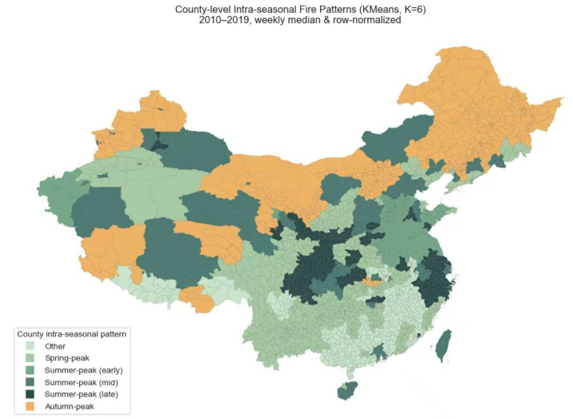
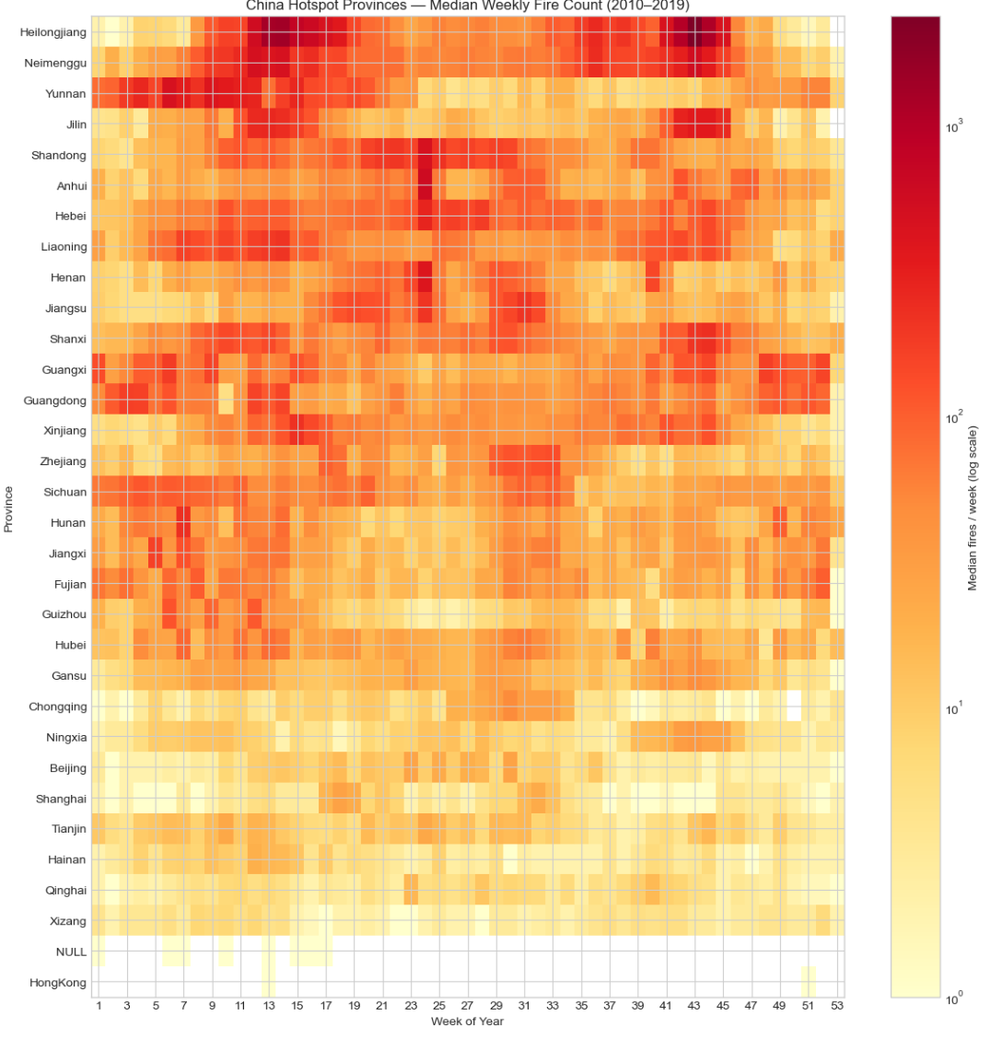
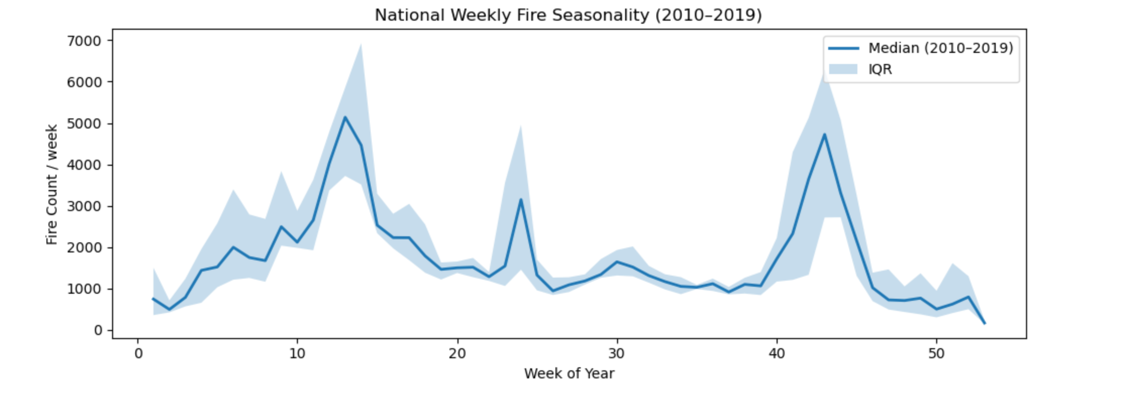
Core Tasks 1: The Dominant Spatiotemporal Patterns of Fire Activity
China Hotspot Provinces--Median Weekly Fire Count (2010-2019)
Key Findings:
Nationwide bi-modal fire season
Spring crop preparation + autumn straw burning are dominant drivers
Climate + crop schedule jointly control fire timing
Map Regional Difference：
Autumn-peak in North & Northeast (grain belt)
Summer or multi-peak in South/Southwest (monsoon agriculture)
Early-spring low-peak in arid regions (Xinjiang)
Spatial heterogeneity requires region-specific management
National Weekly Fire Seasonality (2010–2019)
HKUST(GZ) Investigating Agricultural Burning with Remote Sensing November 5, 2025 2 / 17
Notes:
First, from the line chart, we observe a clear bi-modal fire season at the national scale.
The spring peak in April to June mainly associated with crop preparation
and the autumn peak in Oct to Nove corresponds to straw burning.
Next, the heatmap provides additional validation.
indicating a seasonal differences in climate.
Finally, the spatial clustering map shows distinct regional fire situations.
Northern and Northeastern China --are autumn-dominant.
Southern and Southwestern regions are summer or multi-peak patterns,
And in arid regions like Xinjiang, we see an early-spring low peak.

Slide 3
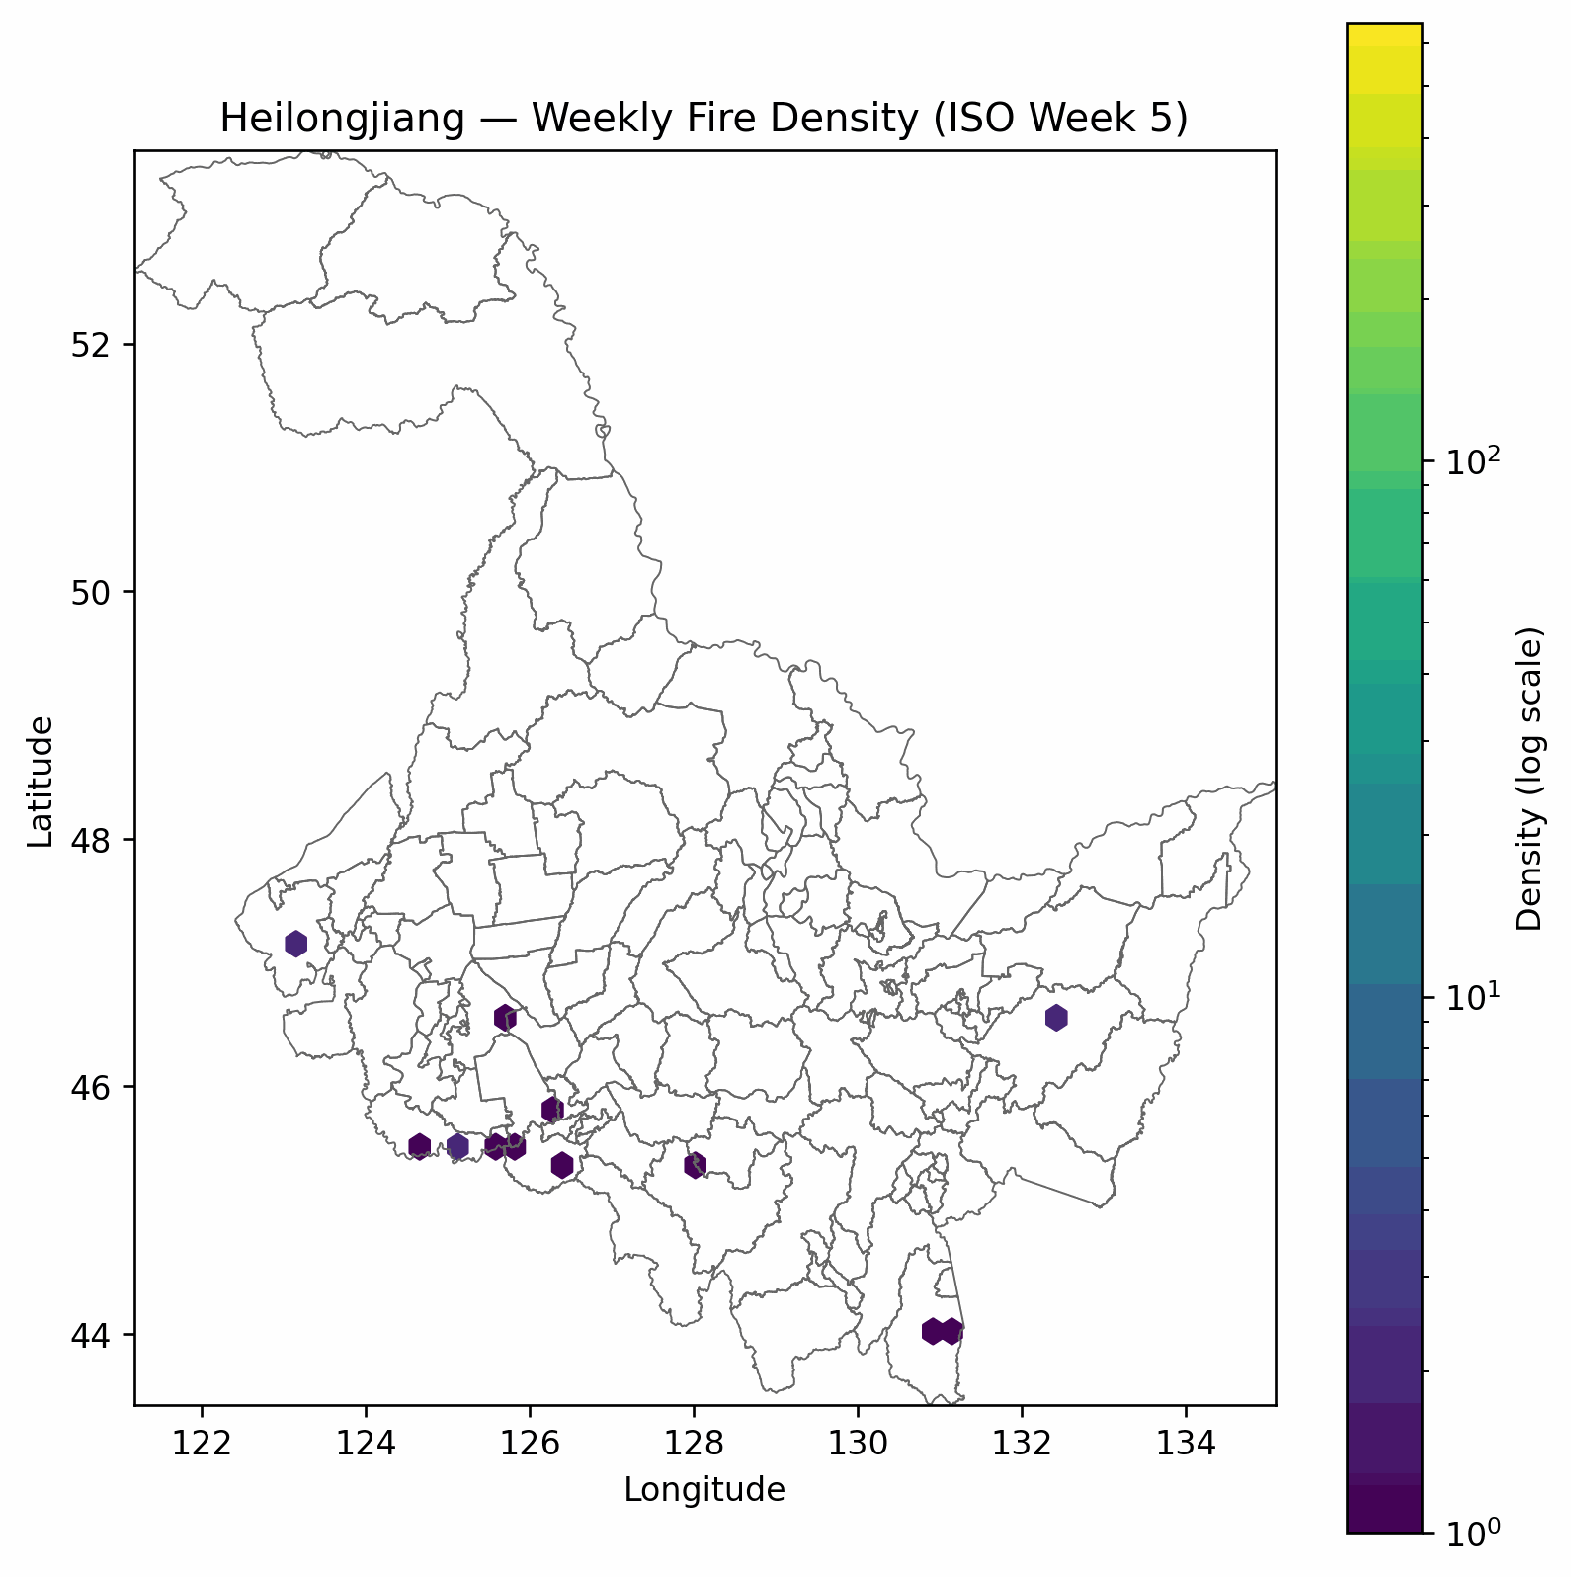
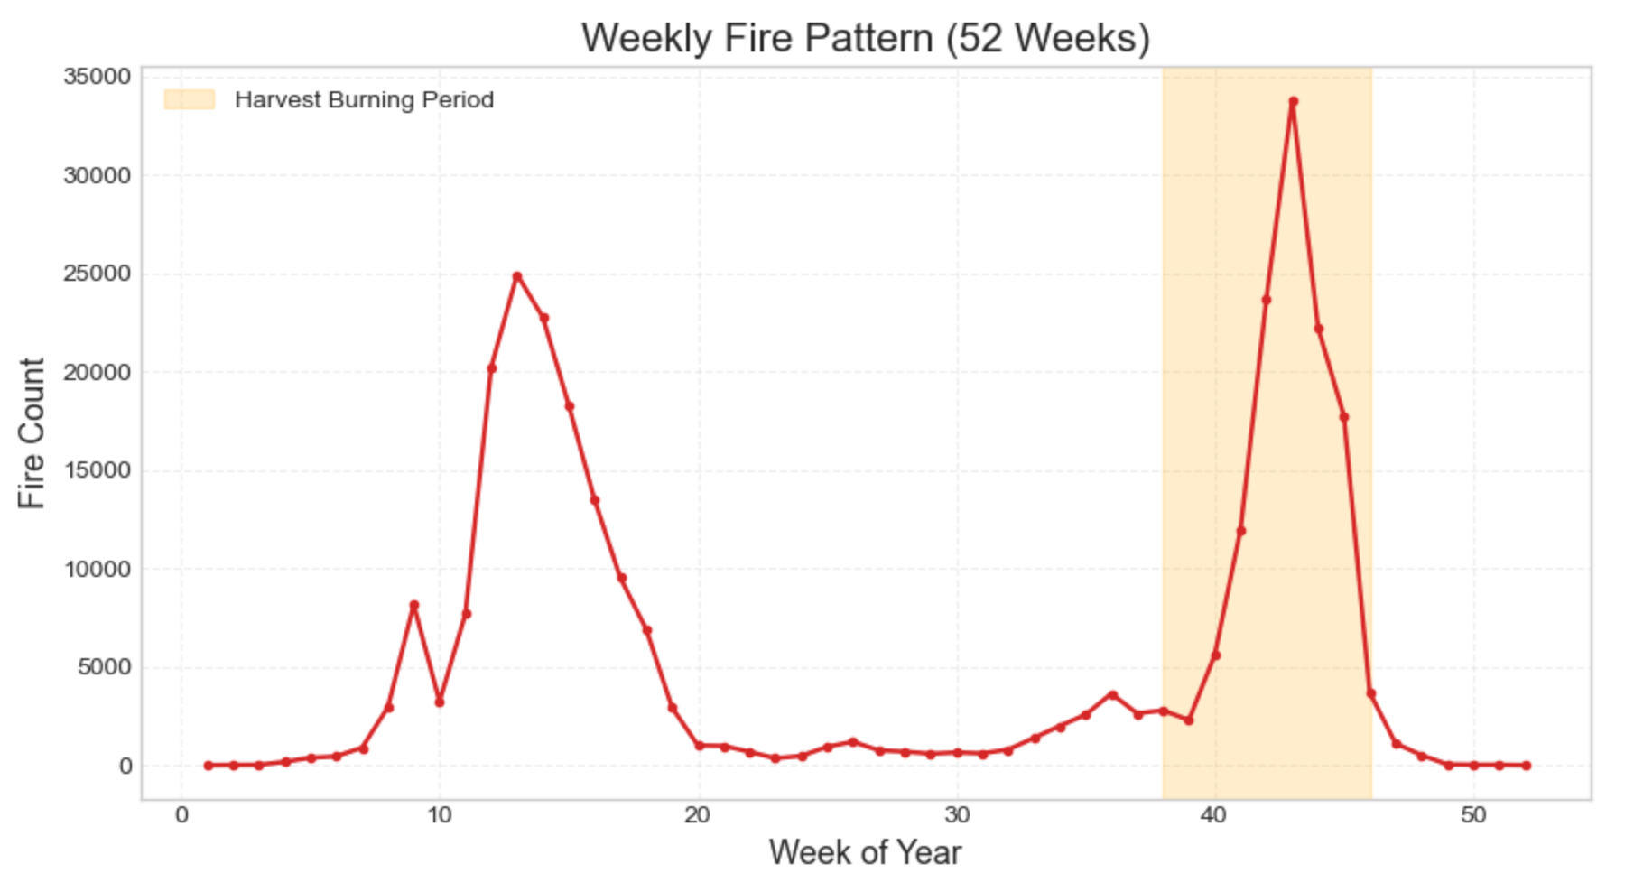
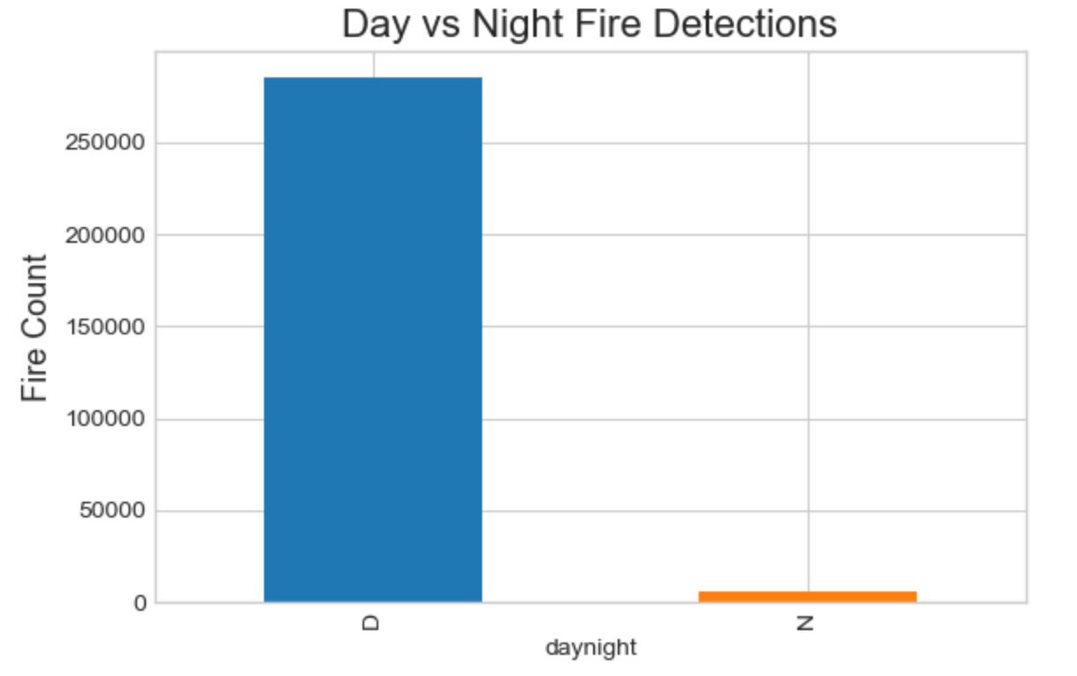
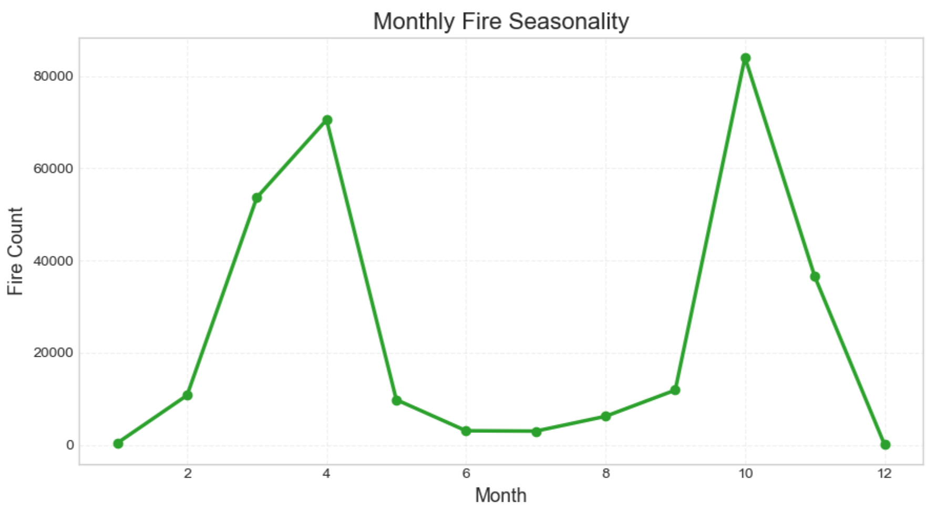
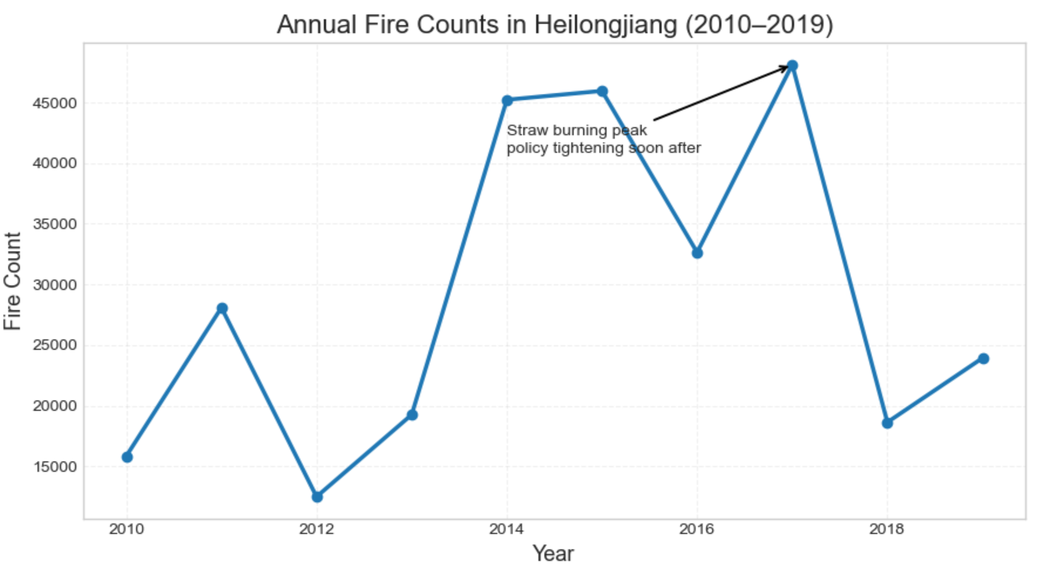
Core Tasks 1: The Dominant Spatiotemporal Patterns of Fire Activity
Scale | Key Findings
Yearly | • Strong policy-linked spikes in 2014–15 & 2017 • Sharp drop after policy tightening • Fires driven by crop cycles + enforcement
Monthly | • Clear bi-modal peaks: April & October • Matches ploughing + post-harvest burning
Weekly | • Two sharp peaks around week 13 & week 41–44 • Highlighted autumn harvest burn window
Day/Night | • Daytime-dominant fires (>95%) • Consistent with deliberate agricultural burning, not wildfires
HKUST(GZ) Investigating Agricultural Burning with Remote Sensing November 5, 2025 3 / 17
Notes:
First, looking at annual fire counts, we see two policy-sensitive peaks, around 2014 and again in 2017.
Fire driven by both crop cycles and policy pressure.
Second, monthly /weekly seasonality followed by the national tendency
it's also highlighted harvest burn window
Finally, almost all fires occur during daytime.
Nighttime fires are extremely rare,
indicating intentional agricultural burns rather than uncontrolled wildfires.

Slide 4
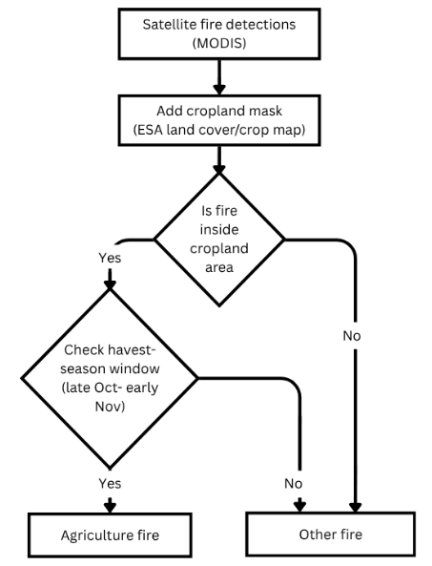
Core Tasks 2: Quantifying Post-Harvest Agricultural Burning in Heilongjiang
Steps：
Detect fire pixels (MODIS FIRMS)
Overlay with cropland map (ESA)
Select points within farmland
Apply harvest calendar filter (late Oct–early Nov)
Output: agricultural vs other fires
We combine spatial proximity to cropland + harvest timing to isolate agricultural burning.
HKUST(GZ) Investigating Agricultural Burning with Remote Sensing November 5, 2025 4 / 17
Notes:
For Core Task 2, our goal is to determine what share of all detected fires can be confidently classified as post-harvest agricultural straw burning.
To do this, we first overlay MODIS fire detections with the ESA cropland map. This allows us to separate fires based on land use. If a fire falls on cropland, we treat it as a potential agricultural fire, while fires outside cropland are considered non-agricultural.
Next, we introduce a timing filter to refine the classification. Since straw burning takes place right after harvest, we only count fires on cropland that occur during the post-harvest period as agricultural burning.
By combining both land-use and timing conditions, we isolate the portion of fire activity that is most likely to be true agricultural residue burning.

Slide 5
Core Tasks 2: Quantifying Post-Harvest Agricultural Burning in Heilongjiang
Component | Data Source | Rule / Logic | Key Parameters
Fire detection | MODIS MCD14DL | FRP > 0, valid confidence | Spatial res = 1 km
Cropland map | ESA WorldCover | Fire point falls in cropland pixel | Spatial res = 300 m
Harvest period | Govt agricultural reports | Fire date within harvest window | DOY 295–320 (Oct 22 – Nov 16)
Temporal filter | Rolling seasonal window | Fire near peak harvest season | Window W = 30 days (tested 21, 30, 45)
FRP threshold | Empirical FRP distribution | Identify small, controlled burns | Percentile cutoff q = 0.85 (tested 0.80, 0.90)
Spatial rule | Point-in-polygon test | Fire located inside cropland | Binary mask
Sensitivity checks | Re-run with alternative params | Robustness to parameter choice | W ∈ {21, 30, 45}, q ∈ {0.80, 0.85, 0.90}
High-precision land cover (ESA 300 m) + MODIS fire detections (1 km)
Conservative rules to avoid over-classifying
W and q sensitivity tested → classification robust
HKUST(GZ) Investigating Agricultural Burning with Remote Sensing November 5, 2025 5 / 17
Notes:
And for this section, we explain how we avoid over-classifying agricultural fires, using three safeguards: an FRP filter, spatial rules, and sensitivity checks.
First, we apply an FRP percentile filter to focus on small, controlled straw burns and exclude high-intensity wildfires. For example, using the 85th percentile keeps FRP values typical of residue burning and filters out unusually strong fires.
Second, we use a strict spatial rule: a fire must fall on mapped cropland to be classified as agricultural. This prevents fires in forests, grassland, or along roads from being misclassified.
Lastly, we run sensitivity checks by varying the FRP threshold and the spatial window. The agricultural share and seasonal pattern remain consistent across these tests, showing that our classification is robust and not driven by any single parameter

Slide 6
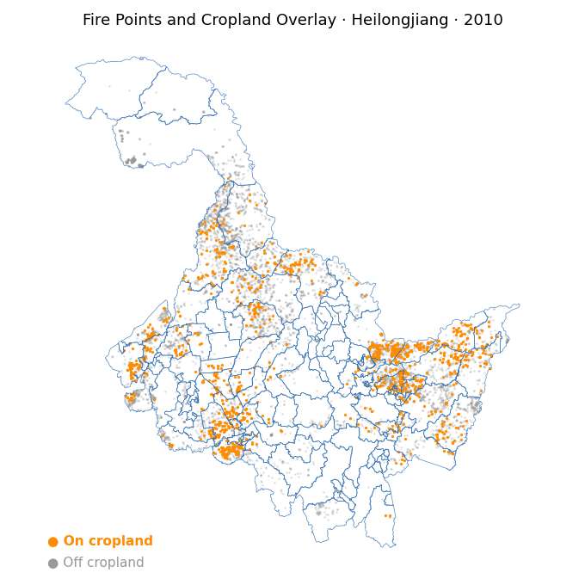
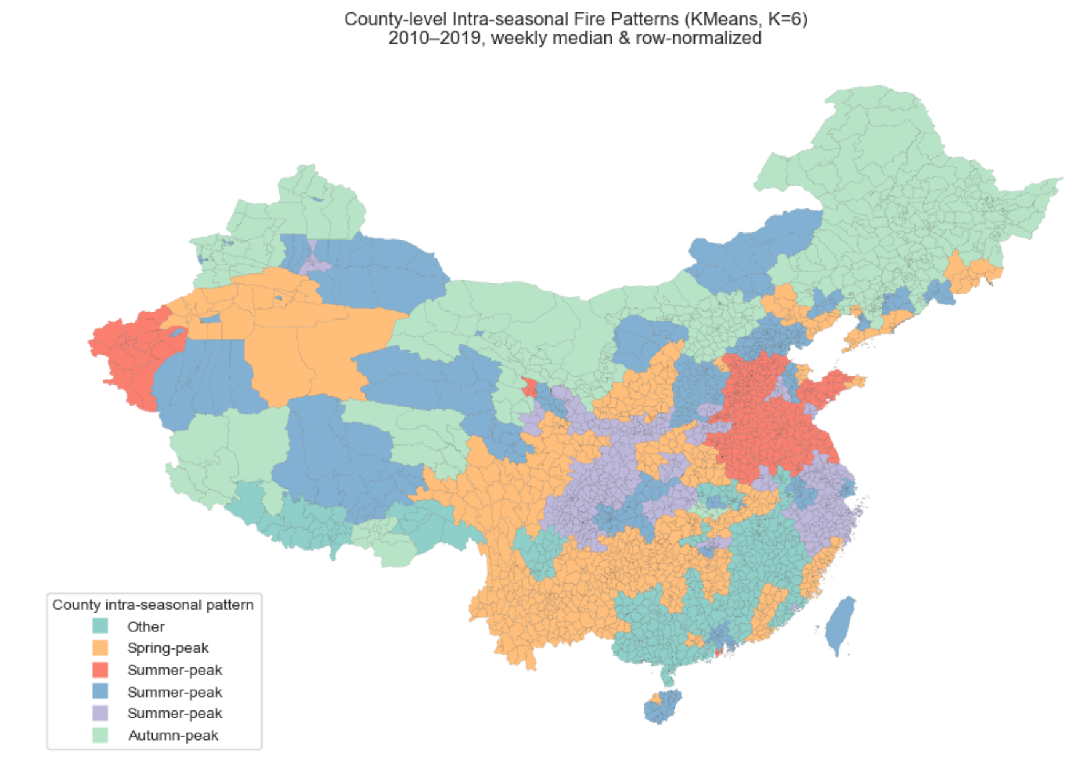
Core Tasks 2: The Dominant Spatiotemporal Patterns of Fire Activity
• Highlights solely on agricultural fire
• Strong spatiotemporal signature → agricultural fires, not random wildfires
• Highest concentrations appear in the eastern and the western of Heilongjiang
• A noticeable decrease in agricultural fire occurrences since 2015, aligning with the province straw-burning ban
HKUST(GZ) Investigating Agricultural Burning with Remote Sensing November 5, 2025 6 / 17
Notes:
After filtering out all non-cropland fires, we produced this animated map to show only agricultural fires from 2010 to 2019.
What immediately stands out is the strong spatial concentration in the eastern and western cropland regions, where most of Heilongjiang’s crop production takes place.
This clear spatiotemporal pattern suggests that the fires are closely linked to post-harvest residue burning rather than random wildfires.
In addition, after 2015, we see a sharp decline in agricultural fire activity. This drop aligns with the provincial straw-burning ban, indicating that the policy had a significant impact on reducing open-field burning.

Slide 7
Core Tasks 2: The Dominant Spatiotemporal Patterns of Fire Activity
Metric | Result | Interpretation
% fires on cropland during harvest window | ~2% overall, spike in late Oct–Nov | Spatial + seasonal match with agriculture
Share drop pre- vs post-2015 | -87.10% | Strong policy suppression effect
Chi-square test | p < 0.001 | Distribution not random
Bootstrap CI | CI excludes 0 | Result robust
County heterogeneity | 56 ↓, 0 ↑ significantly | Widespread policy impact
• ~2% of fires consistently classified as agricultural
• Clear seasonal spike aligned with harvest timing
• Strong drop after 2015 straw-burning ban (-87%)
• Chi-square & bootstrap confirm significance
• Spatially consistent declines across counties
HKUST(GZ) Investigating Agricultural Burning with Remote Sensing November 5, 2025 7 / 17
Notes:
From these results, we find that only around 2% of all detected fires can be classified as agricultural.
However, despite this small share, the trend over time is very clear.
Then, After the 2015 provincial straw-burning ban, agricultural fires fell by roughly 87%, and this reduction is statistically significant based on chi-square tests and bootstrap confidence intervals.
Furthermore, the decline is not limited to just a few locations. We observe consistent reductions across most agricultural counties, which reinforces that the fires we classified are genuinely linked to crop-residue burning rather than other types of fires.
Overall, although agricultural burning accounts for a small portion of total fire activity, it displays a clear and consistent pattern that can be reliably isolated, measured, and meaningfully tracked over time.

Slide 8
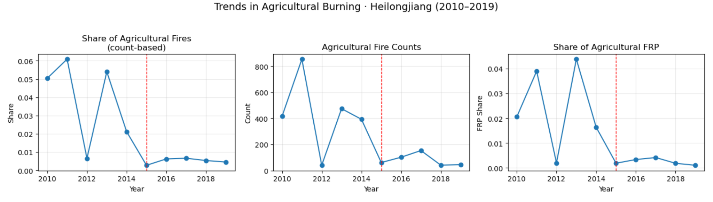
Core Tasks 3: Long-Term Spatiotemporal Trends of Fire Activity (2010–2019)
Metric | Result | Interpretation
Pre share (2010–14) | ~3.9% | Baseline
Post share (2015–19) | ~0.5% | After ban
Drop | −87.1% | Strong policy effect
Chi-square | p < 0.001 | Difference significant
Bootstrap CI | excludes 0 | Robust
HKUST(GZ) Investigating Agricultural Burning with Remote Sensing November 5, 2025 8 / 17
Notes:
Now I will present the long-term spatiotemporal trends of agricultural burning in Heilongjiang from 2010 to 2019.
The three line charts show the share of agricultural fires, the agricultural fire count, and the share of FRP.
As we can see, there is a clear structural break around 2015, when strict straw-burning policies were introduced.
Before the ban, agricultural fires accounted for around 4% to 6% of total detections.
After 2015, this number dropped sharply to around 0.5%, and both the fire count and FRP show the same downward pattern.
This suggests not only fewer agricultural fire detections, but also a large reduction in burning intensity.
The table summarizes our quantitative results.
The agricultural-fire share fell by 87.1%, and the chi-square test gives p < 0.001, meaning the change is statistically significant.
Bootstrap confidence intervals exclude zero, confirming the effect is robust.
Overall, these results provide strong evidence that the post-2015 straw-burning policy substantially suppressed agricultural fires across the province.

Slide 9
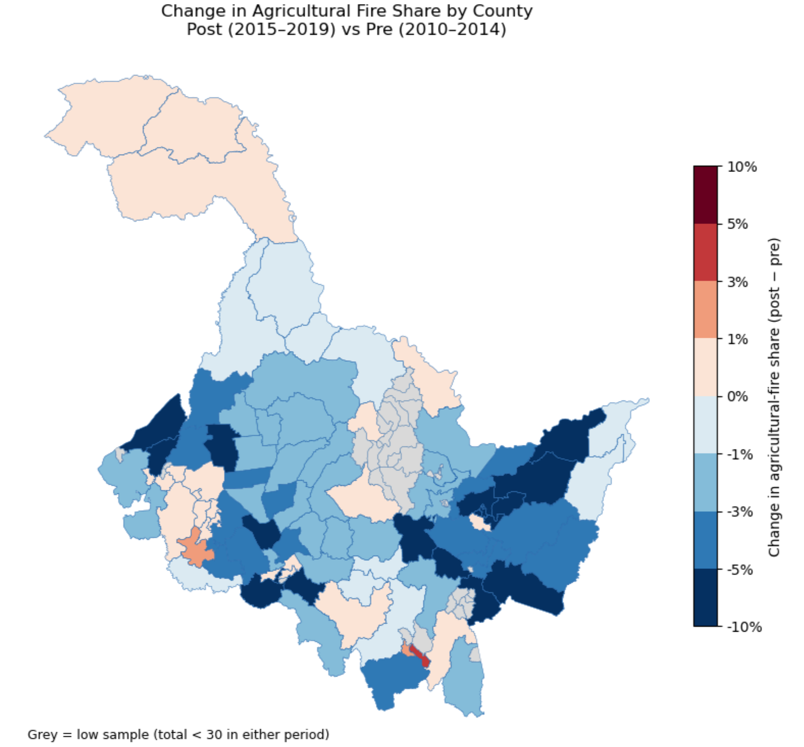
Core Tasks 3: Long-Term Spatiotemporal Trends of Fire Activity (2010–2019)
Most counties show declines (56 significant ↓, 0 significant ↑)
Stronger improvements in southern grain belt
Policy impact spatially consistent
HKUST(GZ) Investigating Agricultural Burning with Remote Sensing November 5, 2025 9 / 17
Notes:
At the county level, 56 counties show significant decreases, and none show increases.
Reductions are strongest in major crop-producing regions, indicating targeted enforcement worked.
Overall, there is strong evidence that the post-2015 ban substantially reduced agricultural fire activity across Heilongjiang — both statistically and spatially.

Slide 10
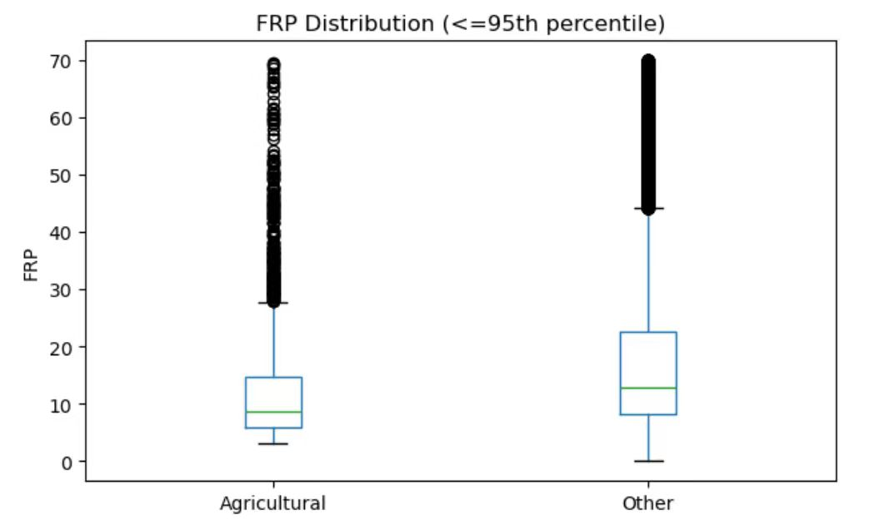
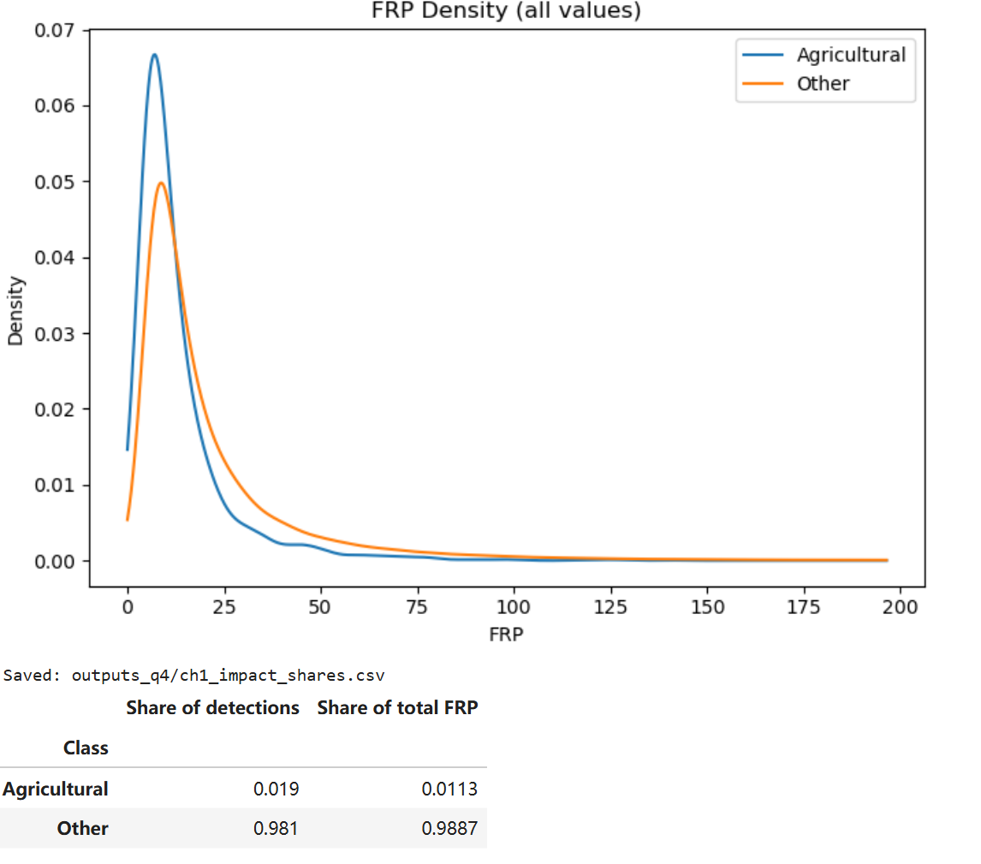
Core Tasks 4: The distinct characteristics that distinguish agricultural fires from other types of fires
Statistical test | Result | Interpretation
Mann–Whitney U | U = 1.17 × 10⁸, p < 1e−168 | Agricultural FRP significantly lower than other fires
Cliff’s Delta | δ = −0.312 | Medium effect size (agricultural < other)
Agricultural fires show lower FRP
Median: 8.7 vs 13.5
Upper tail gap widens (P90 26 vs 47.5)
Mann-Whitney test: p < 1e-160
Cliff’s delta: −0.31 (medium effect)
→ Agricultural fires are smaller & less intense
HKUST(GZ) Investigating Agricultural Burning with Remote Sensing November 5, 2025 10 / 17
Notes:
First, we compare fire intensity.
From both the boxplot and density curve, agricultural fires clearly have lower FRP values.
The median FRP is around 8.7 for agricultural fires versus 13.5 for other fires, and the difference widens in the higher percentiles.
The Mann–Whitney test confirms the distributions differ significantly, with p < 1e-160, and Cliff’s delta of -0.31 indicates a medium effect size.
This suggests agricultural fires tend to be smaller, shorter-duration burns, consistent with residue burning practices.

Slide 11
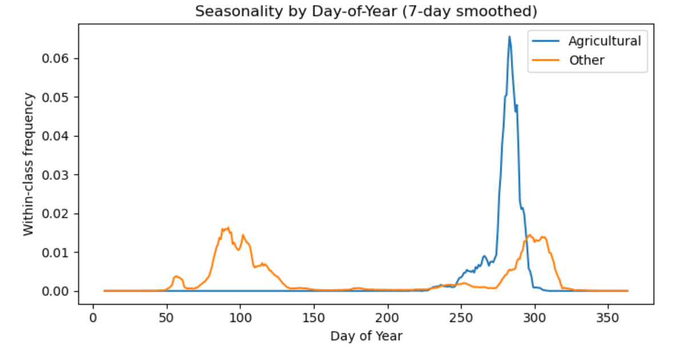
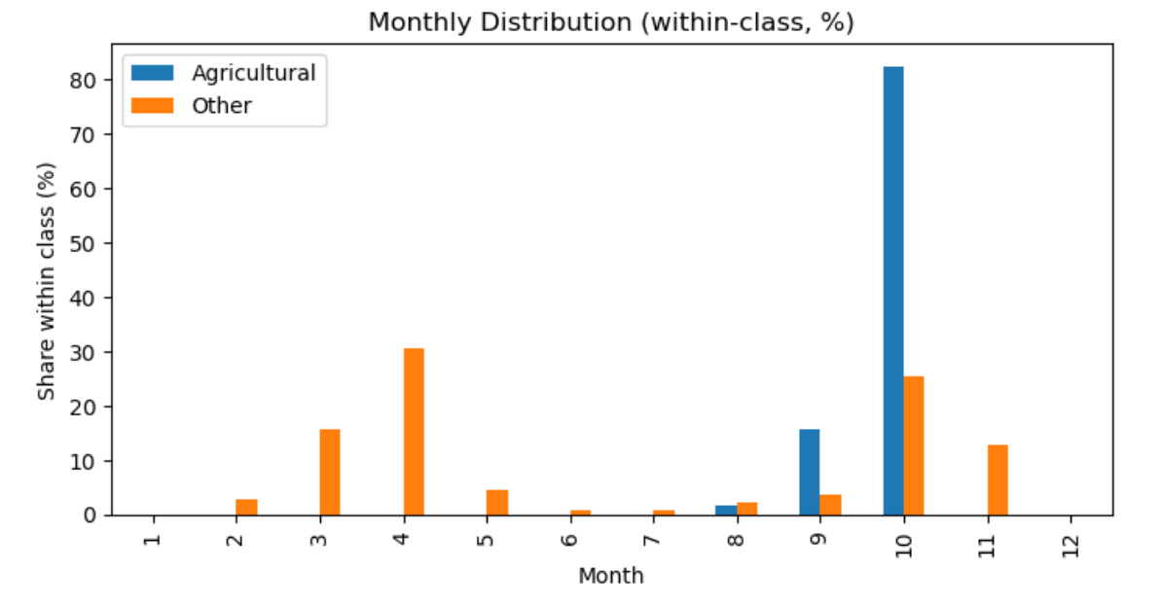
Core Tasks 4: The distinct characteristics that distinguish agricultural fires from other types of fires
Agricultural fires peak Day ~280–310 (late-Oct to mid-Nov)
~80% occur in October
Non-agri fires distributed across spring/summer too
HKUST(GZ) Investigating Agricultural Burning with Remote Sensing November 5, 2025 11 / 17
Notes:
Beyond intensity, timing is also distinct.
The day-of-year plot shows agricultural fires are highly concentrated in late October, immediately after the harvest season.
In contrast, other fires peak in spring and early summer, driven by forest and grassland ignition patterns.
Looking at the monthly chart, about 80% of agricultural fires occur in October, while the non-agricultural class spreads more broadly across the year.
This seasonal concentration strongly supports our classification — agricultural fires align with the post-harvest field clearing window, unlike other fires.

Slide 12
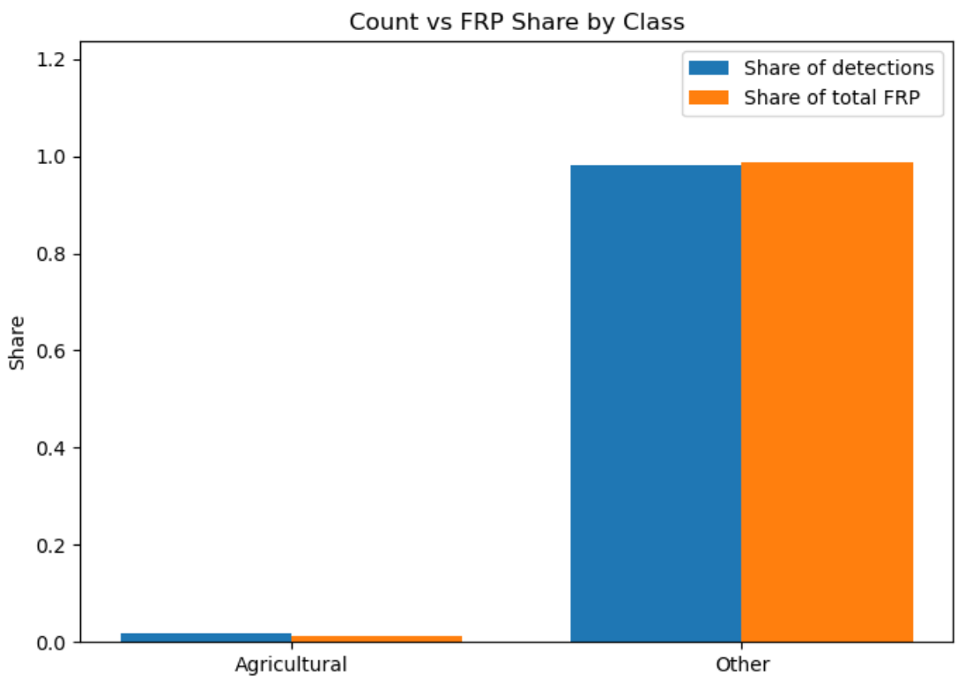
Challenge 1: Intensity and Impact Analysis
Key Findings：
Agricultural fires = ~2% of detections but only ~1% of total FRP
FRP distribution significantly lower (U-test p < 0.001; Cliff’s δ ≈ −0.32)
Interpretation: many small, low-energy burns
Implications：
Agri burning contributes smoke + seasonal peaks, but not extreme fire events
Enforcement & monitoring should focus on post-harvest windows (Oct) and hotspot areas
HKUST(GZ) Investigating Agricultural Burning with Remote Sensing November 5, 2025 12 / 17
Notes:
In Challenge 1, we asked whether agricultural fires are major sources of fire intensity.
Using MODIS FRP as an intensity proxy, we find that agricultural fires are numerous but weak.
They account for about 2% of detections but only ~1% of total energy released, and statistical tests confirm their FRP is significantly lower.
This suggests that agricultural burns in Heilongjiang are frequent, small-scale burning events, mainly post-harvest smoke rather than major wildfires.
Policy-wise, this means targeted enforcement in October and known agricultural hotspots is more effective than broad suppression strategies.

Slide 13
Challenge 2: Methodological Limitations and Uncertainty
Issue | Effect | Bias
MODIS 1km resolution | Miss small farm fires | ↓ Underestimates agri fires
Cropland map errors | Settlements mistaken as farms | ↑ False positives
Fixed harvest calendar | Ignores yearly shifts | Timing mismatch
FRP only measures peak | Smoldering undervalued | ↓ Underestimates intensity
Overall bias: Our method likely underestimates agricultural burning.
Dataset | Benefit
VIIRS 375m fire | Detect small agricultural fires
Sentinel-2 cropland mask | Cleaner cropland boundaries
Crop phenology data | Real harvest timing
Soil moisture (SMAP) | Remove non-agri wet-season fires
Combine MODIS + VIIRS + Sentinel-2 + dynamic crop calendars
HKUST(GZ) Investigating Agricultural Burning with Remote Sensing November 5, 2025 13 / 17
Notes:
For Challenge 2, we evaluated uncertainty in our classification method.
MODIS’s 1-kilometer resolution may miss small agricultural burns, and cropland maps can mislabel rural settlements, creating false positives.
We also used a fixed harvest calendar, which ignores yearly variation, and FRP captures only peak intensity, so agricultural smoldering fires may appear weaker.
Overall, these limitations likely mean we underestimate agricultural burning and intensity.
To improve accuracy, we recommend combining MODIS with higher-resolution VIIRS fire detections, using Sentinel-2 cropland masks, adopting dynamic crop phenology calendars, and adding soil-moisture filters.
These upgrades would significantly reduce both spatial and seasonal misclassification and provide more reliable agricultural fire estimates.

Slide 14
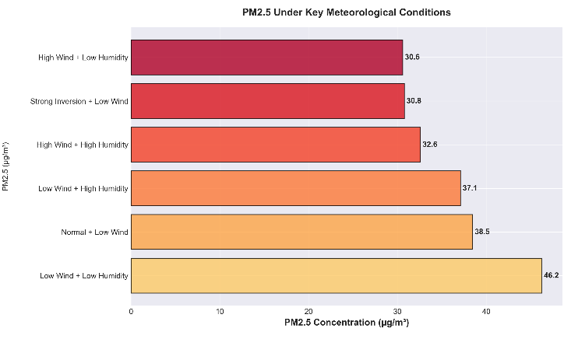
Challenge 3: Meteorology & Pollution
How do meteorological conditions affect the detection and environmental impact of straw burning?
1.Wind Speed Has the Greatest Impact:
Low Wind Speed (<2 m/s): PM2.5 37.90 µg/m³
High Wind Speed (≥5 m/s): PM2.5 31.86 µg/m³
Correlation: r = -0.086, p < 0.001
Practical Impact: 19% higher PM2.5 at low wind speeds vs. high speeds
2.Humidity Affects Detection:
Low Humidity (<50%): Highest fire detection rate (60.3%)
High Humidity (≥70%): Lower detection rate (possibly due to cloud cover)
3.Worst-Case Scenario:
Low Wind Speed + Low Humidity → PM2.5 46.25 µg/m³
HKUST(GZ) Investigating Agricultural Burning with Remote Sensing November 5, 2025 14 / 17
Notes:
In Challenge 3, we focused on the impact of straw burning on air quality in Heilongjiang, and we tried to answer two core questions.
Question 1: The Impact of Weather
First question: How does weather affect straw burning?
We found that among all meteorological factors, wind speed is decisive. Our data shows a clear pattern: When the wind stops, the pollution stacks up.
During low wind speeds, PM2.5 concentrations were nearly 20% higher than during high wind speeds. This confirms that wind is nature's 'natural cleaner' for pollution.
Humidity, on the other hand, mainly impacts our satellite detection. Simply put, the drier the weather, the easier it is for satellites to 'see' the fires.
So what's the worst-case scenario? It's when it's both dry and still (low wind + low humidity). Under these conditions, PM2.5 concentrations peak, and the risk of pollution accumulation is highest.

Slide 15
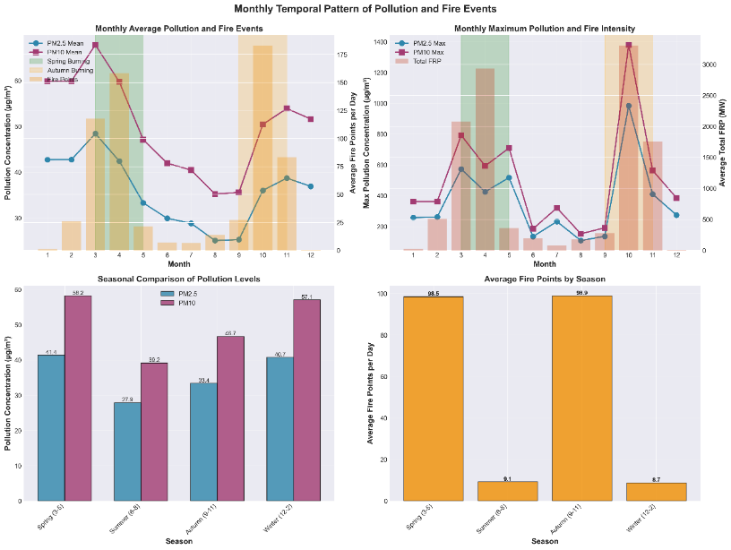
Challenge 3: How can the timing of pollution peaks be linked to straw burning events?
1.Pollution Peak → Straw Burning Event:
When PM2.5 ≥ 75th percentile: 45.3% had same-day straw burning (620/1370 days)
54.2% had straw burning within a ±3 day window
Extreme Pollution (PM2.5 > 100): 80.6% had same-day straw burning (25/31 days)
2.Straw Burning Peak → Pollution Peak:
When Straw Burning ≥ 90th percentile: 46.8% had a same-day pollution peak (257/549 days)
PM2.5 on peak-burning days: 46.73 µg/m³ vs. 34.62 µg/m³ on non-burning days
Difference: +35%
3.Time Window:
Best correlation window: ±3 days
Indicates pollution may be directly caused by burning or have a 1-3 day lag
HKUST(GZ) Investigating Agricultural Burning with Remote Sensing November 5, 2025 15 / 17
Notes:
Question 2: Linking Pollution to Burning
Second question: How can we be sure that pollution peaks are actually caused by straw burning?
To answer this, we did a two-way investigation: We traced back from pollution peaks to find fires, and we also looked forward from fire outbreaks to see the pollution.
The results were striking. First, let's look at the most polluted days—for example, extreme events where PM2.5 was over 100. We found that over 80% of these extreme pollution events were directly linked to same-day straw burning. This is very strong evidence.
The reverse is also true. On days with the most intense straw burning, the air quality almost half the time worsened immediately, with PM2.5 concentrations spiking by 35%.
We also found a ±3 day time window, which suggests pollution can be immediate, or it can have a lag of a few days.
Conclusion
So our conclusion is clear: First, wind speed is the key factor deciding pollution dispersal. And second, pollution peaks are highly correlated in time with straw burning—and for extreme events, over 80% are caused by it."

Slide 16
Conclusion
Conclusion & Policy Implications
Clear dual-peak fire seasonality (spring + harvest)
Agricultural burning dominates Heilongjiang patterns
Post-2015 policy tightened → sharp & sustained decline
Agricultural fires = low-intensity but high seasonal pollution
Targeted monitoring & seasonal enforcement needed
Promote residue recycling & alternatives to open burning
HKUST(GZ) Investigating Agricultural Burning with Remote Sensing November 5, 2025 16 /17
Notes:
To conclude, our analysis reveals that China’s agricultural burning is highly seasonal, spatially concentrated, and policy-responsive.
Nationwide, fires follow a clear dual-peak pattern linked to planting and harvest cycles. Heilongjiang – the country’s largest grain base – shows textbook agricultural burning: strong April and October peaks, daytime detections, and moderate FRP.
Importantly, after the 2015 straw-burning ban, agricultural fire counts dropped sharply and consistently across counties, demonstrating effective policy impact.
While agricultural fires account for only a small share of total fire detections and FRP, they drive seasonal haze events and remain a key management priority.
Moving forward, targeted seasonal enforcement, multi-sensor monitoring, and region-specific crop-residue solutions are essential to sustain progress.

Slide 17
Thank you for listening !
HKUST(GZ) Investigating Agricultural Burning with Remote Sensing November 4, 2025 17 / 17

